Slide 1
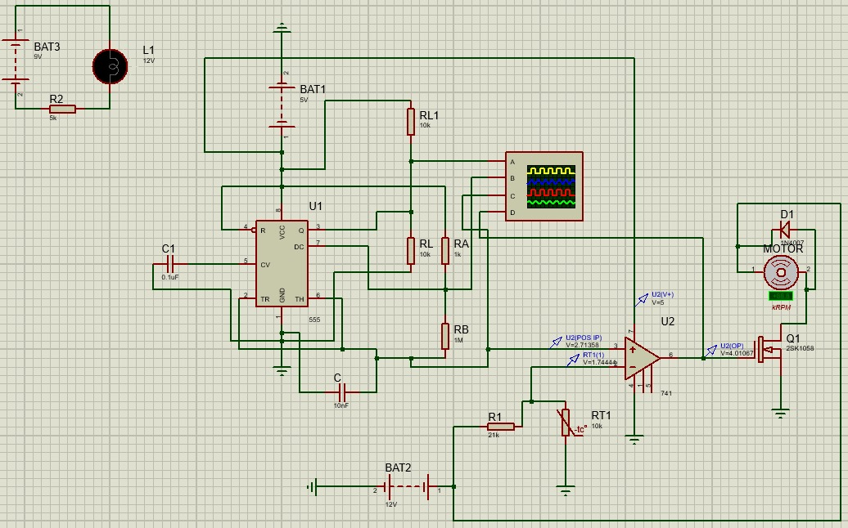
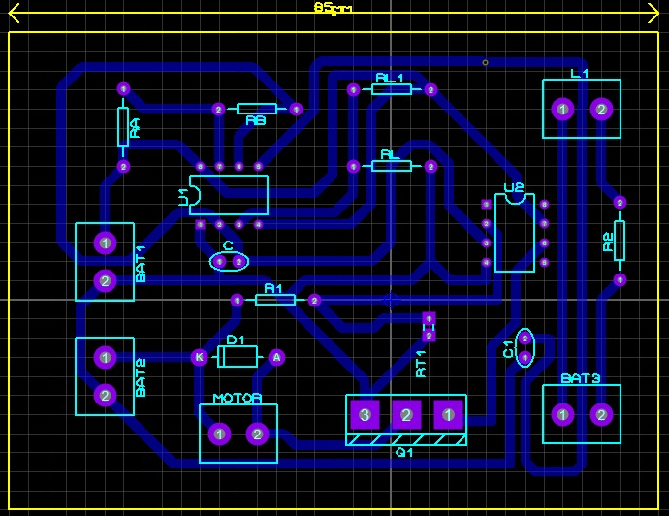
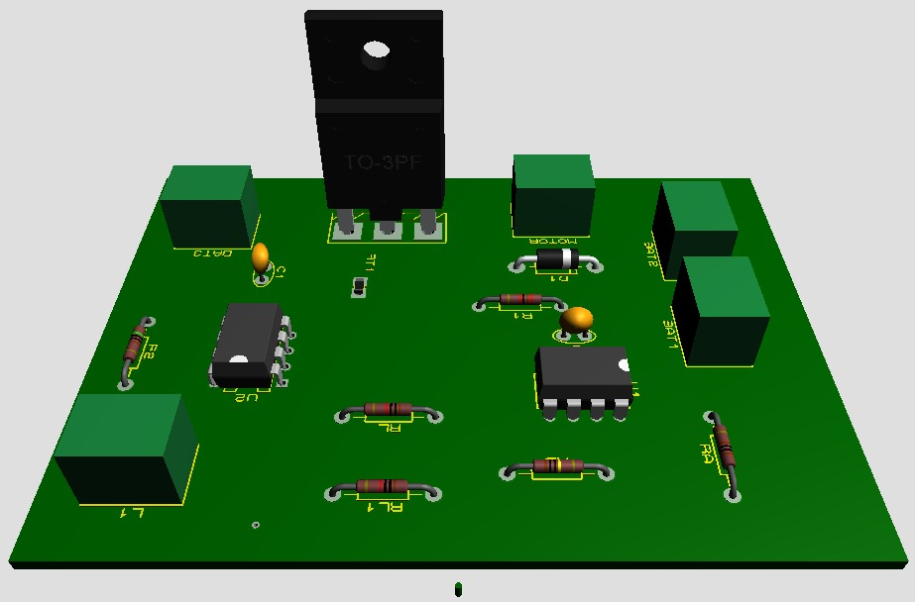


Cooling System
Zain-ul-Abidin, Ghulam Mustafa Bashir, Muhammad Turab
Department of Electrical Engineering, School of Science and Engineering, LUMS, Lahore, Pakistan
Introduction
Block Diagram
Cooling systems serve the purpose of removing heat from a region to provide an ideal surrounding temperature.
We will be designing a circuit that varies the speed of a DC fan depending upon the temperature in real time. To collect data about the surrounding temperature we will be using an LM35 temperature sensor. This will give us a small voltage output that linearly with temperature.
555 Timer in Astable Mode
LM741 comparator
NMOS Mosfet
DC Fan
Potential divider circuit using NTC Thermistor
Applications
There are many situations where extreme temperatures might slow down productivity or may even be dangerous. In such cases cooling systems come in handy absorbing heat and dispersing it elsewhere thus creating an artificial ambient temperature. These systems have uses ranging from households to manufacturing plants and everything in between. A cooling system might be a simple DC fan or a highly complex cooling mechanism incorporating several factors depending upon the purpose. In our case we will be designing a temperature-controlled DC fan.
Results and Outcomes
Proposed Approach
We operate the 555 timer in Astable mode. In Astable mode, the 555 timer acts as an oscillator that generates a square wave and a triangular wave. The frequency of the wave can be adjusted by changing the values of two resistors and a capacitor connected to the chip.
The varying triangular wave is fed into a 741 comparator where it is compared against a reference voltage. The comparator provides either +5 Vcc or ground voltage depending on the result of the comparator thus making a square wave.
The reference voltage is provided by a potential divider circuit consisting of an NTC thermistor paired with a resistor. The reference voltage therefore changes exponentially with change in temperature. This affects the duty cycle of the output of the comparator in effect creating a pulse width modulated wave.
This wave is finally led to the gate of an NMOS Mosfet. A DC fan is attached to Vcc at one end and the drain of the mosfet at the other end. The source is grounded.
As the duty cycle of the comparator output varies so does the speed of DC fan in essence creating a temperature controlled fan.
Conclusions
Future Work
The 555 timer IC is an integrated circuit (chip) used in a variety of timer, pulse generation, and oscillator applications. The 555 can be used to provide time delays, as an oscillator, and as a flip-flop element. It is a cheap yet versatile electronics component. In our case we used it as an oscillator.
When coupled with other components it can be used to achieve complex tasks. We interfaced it with a comparator to generate a pulse width modulating wave.
We learned about the properties of several electronics components including Mosfets and NTC Thermistor.
Using a better method of generating a reference voltage that allows us to generate a larger range of variation. Right now our circuit operates in the range of 30 degrees to 50 degrees..
Using a more sensitive and linear instrument to take our input instead of an NTC Thermistor which has a non linear property.
Using a more powerful data processing system in place of a 555 Timer. We could instead use a microcontroller for greater flexibility and reliability when analyzing data.
EE-340L: Devices and Electronics Lab

